Slide 1
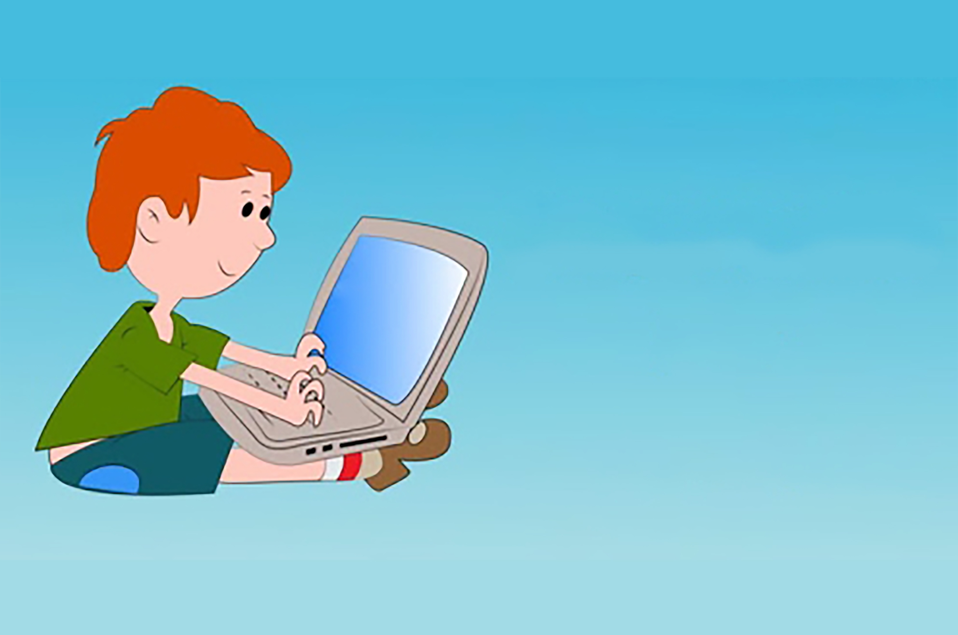

Programming
for
Kids

Slide 2


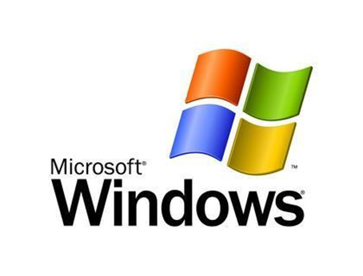
Basic Concepts
Introduction to Java
Platform Independent
Portable
Robust
Dynamic
Write Once, Run Anywhere

Slide 3
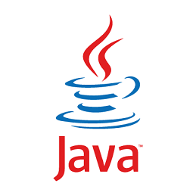
Question?
Introduction to Java
When you are putting your application on several different platforms, how many Java versions do you need to create?
Answer: One

Slide 4
Introduction to Java
Google’s Android OS
Desktop Applications
Antivirus Programs
Web Applications
Enterprise Applications

Slide 5

First Java Program
Introduction to Java
}
class MyClass {
public static void main (String[] args) {
System.out.println(“Hello World!”);
}
}
In Java every line of code must be inside of a class
1
st
Question?
program
What is the name of the above class?

Slide 6
First Java Program
Introduction to Java
}
class MyClass {
public static void main (String[] args) {
System.out.println(“Hello World!”);
}
}
In Java every line of code must be inside of a class
1
st
Question?
program
What is the name of the above class?
Answer: MyClass

Slide 7
First Java Program
Introduction to Java
}
Every application must have a main method, and main must have the keywords public and static.
class MyClass {
public static void main (String[] args) {
System.out.println(“Hello World!”);
}
}
1
st
Question?
program
What is the starting point for every Java Program?

Slide 8
First Java Program
Introduction to Java
}
Also, every application must have a main method, and main must have the keywords public and static.
class MyClass {
public static void main (String[] args) {
System.out.println(“Hello World!”);
}
}
1
st
Question?
program
What is the starting point for every Java Program?
Answer: main

Slide 9
First Java Program
?
Introduction to Java
class MyClass {
public static void main (String[] args) {
System.out.println(“Hello World!”);
}
}
1
st
Question?
program
What are the two keywords every main must have?

Slide 10
First Java Program
?
Introduction to Java
class MyClass {
public static void main (String[] args) {
System.out.println(“Hello World!”);
}
}
1
st
Question?
program
What are the two keywords every main must have?
Answer: public and static

Slide 11
The Main Method
Introduction to Java
public static void main (String[] args) { }
Public – anyone can access it
public
static
void
main
Static – can be ran without creating an instance of the class containing the main method
Void – doesn’t return any value
Main – the name of the method

Slide 12
Question?
Introduction to Java
How would you create a method that doesn’t return any value called “hello()”?
Answer: void hello(){}

Slide 13
println Method
Introduction to Java
}
System.out.println(“Hello World!”);
prints Hello World! to the console
Question?
1
st
What method prints a line of text in a Java Program?
program
Answer: println

Slide 14
Semicolons in Java
Introduction to Java
}
In Java, each code statement must end with a semicolon ;
I am learning Java!
System.out.println (“ ”) ;
you can put any line of text inside the double quotes
1
st
program

Slide 15
Semicolons in Java
Introduction to Java
}
In Java, each code statement must end with a semicolon ;
I am good looking!
I am a smart kid!
I love to code!
System.out.println (“ ”) ;
you can put any line of text inside the double quotes
1
st
program

Slide 16
Fill in the blanks
Introduction to Java
_________ Apples {
public static void _______ (String [ ] args) ___
System.______._______(“Hello World”)___
}
____

Slide 17
Fill in the blanks
Introduction to Java
class
_________ Apples {
public static void _______ (String [ ] args) ___
System.______._______(“Hello World”)___
}
____
main
{
out
println
;
}
7 blanks

